Slide 1

Manufacturing Defect Analysis
By: Ashley Littles

Slide 2
Increase In Defects
As a company we have noticed the increase in demand for the manufactured products we produce.
With this increase in demand there has also been an increase in defects.
The errors we are experiencing are solder bridge defects, lifted components, missing components, insufficient solder, excessive solder, and damaged components.
To be in compliance with the IPCA-610E standard for electronic components, we must correct the defects.
We will be completing a project to improve the manufacturing defects with two ideal outcomes.
Notes:
In Tijuana, Mexico a manufacturing company has been building electronic boards that end up going through a welding process. The company has recently been experiencing an increase in demand for the products they produce while simultaneously noticing that within the welding process of the electronic boards and the components named Thru-Holes has also had an increase in defects. The known defects are missing components, damaged components, lifted components, solder bridge defect, insufficient solder, and excessive solder. These defects have ultimately led to an insufferable increase in the number of assembly and electronic test issues after these electronic boards have gone through the final process of the assembly. The manufacturing companies desired outcomes for this issue are completing a project to reduce the number of defects produced during the manufacturing process by 20% and increase the capacity of their three double production lines where they produce and process the electronic boards by 20%. The manufacturing company would like to achieve these outcomes without any increase in the percentage of defects.

Slide 3
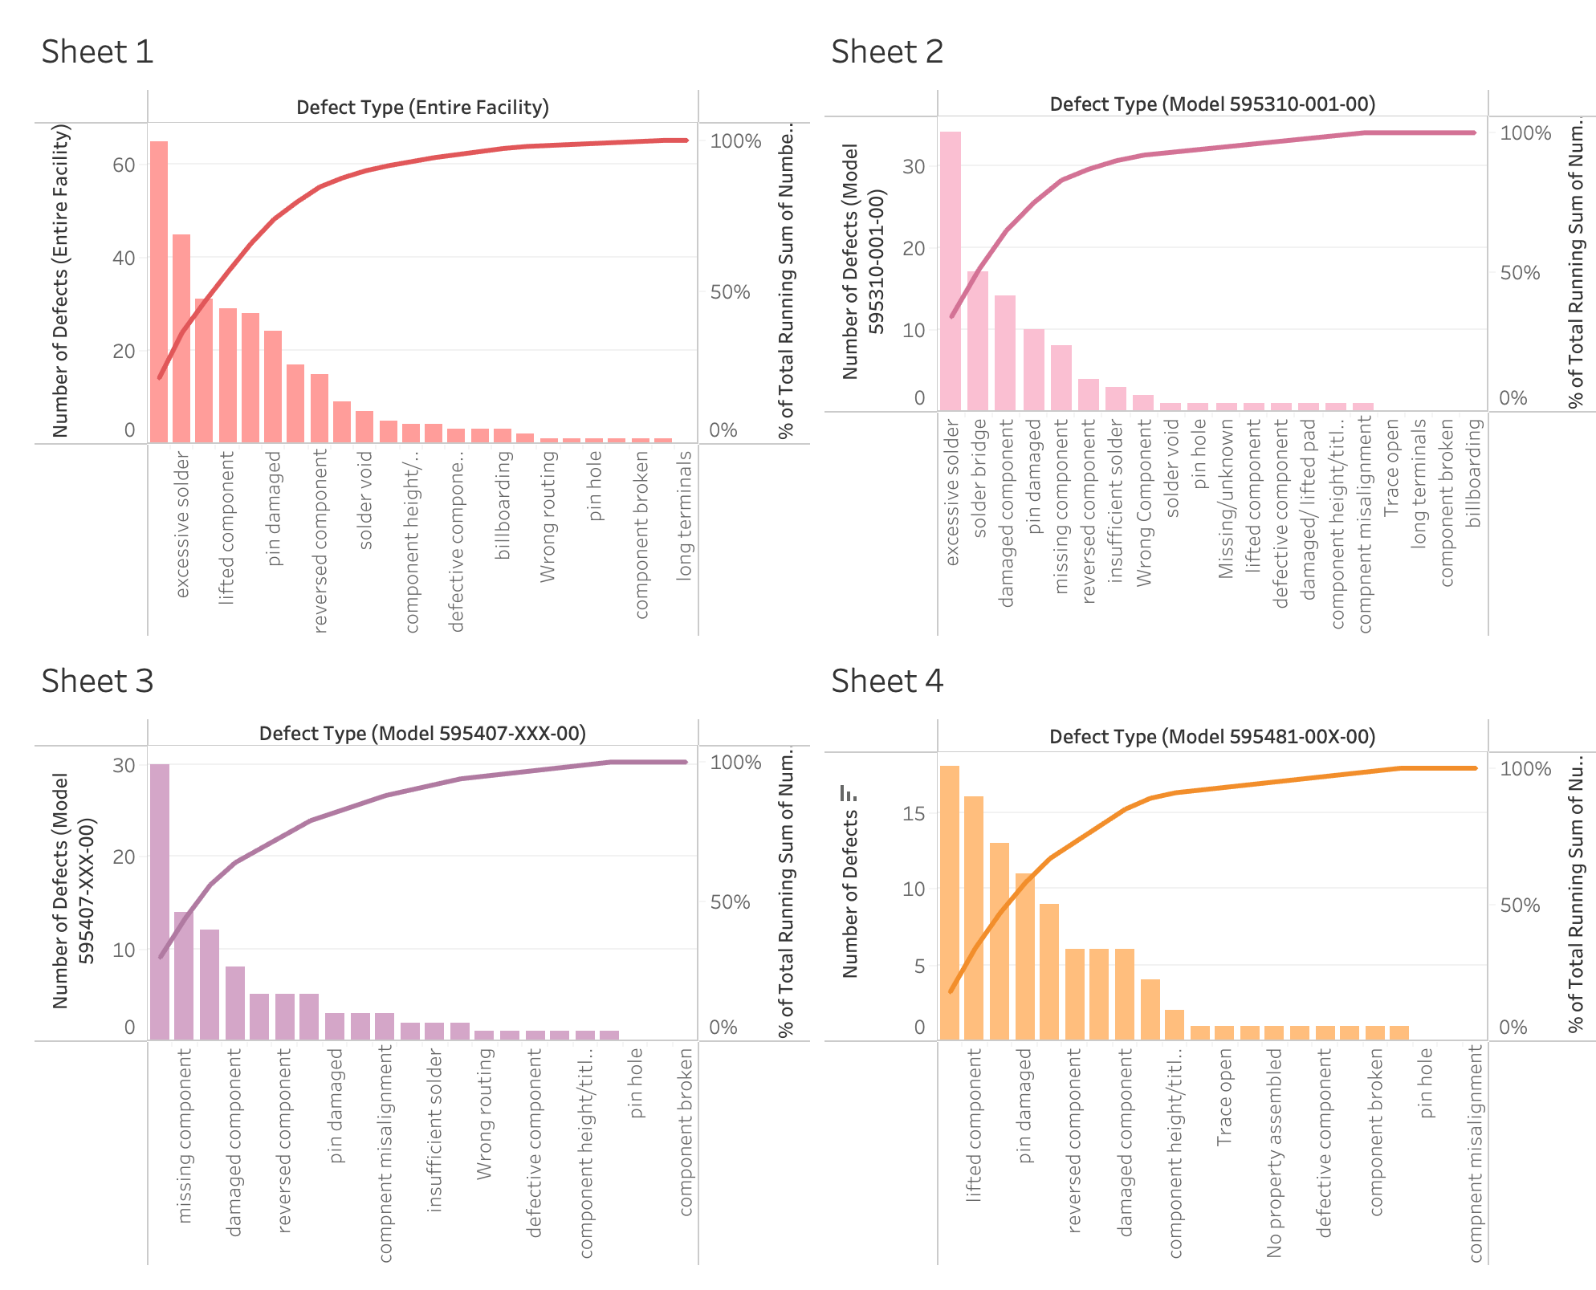
The Pareto Charts
The completed pareto charts for the entire facility and the three models.
Notes:
For this analysis we have created four pareto charts for the defects of the entire facility, model 595310-001-00, model 595407-XXX-00, and model 595481-00X-00.

Slide 4
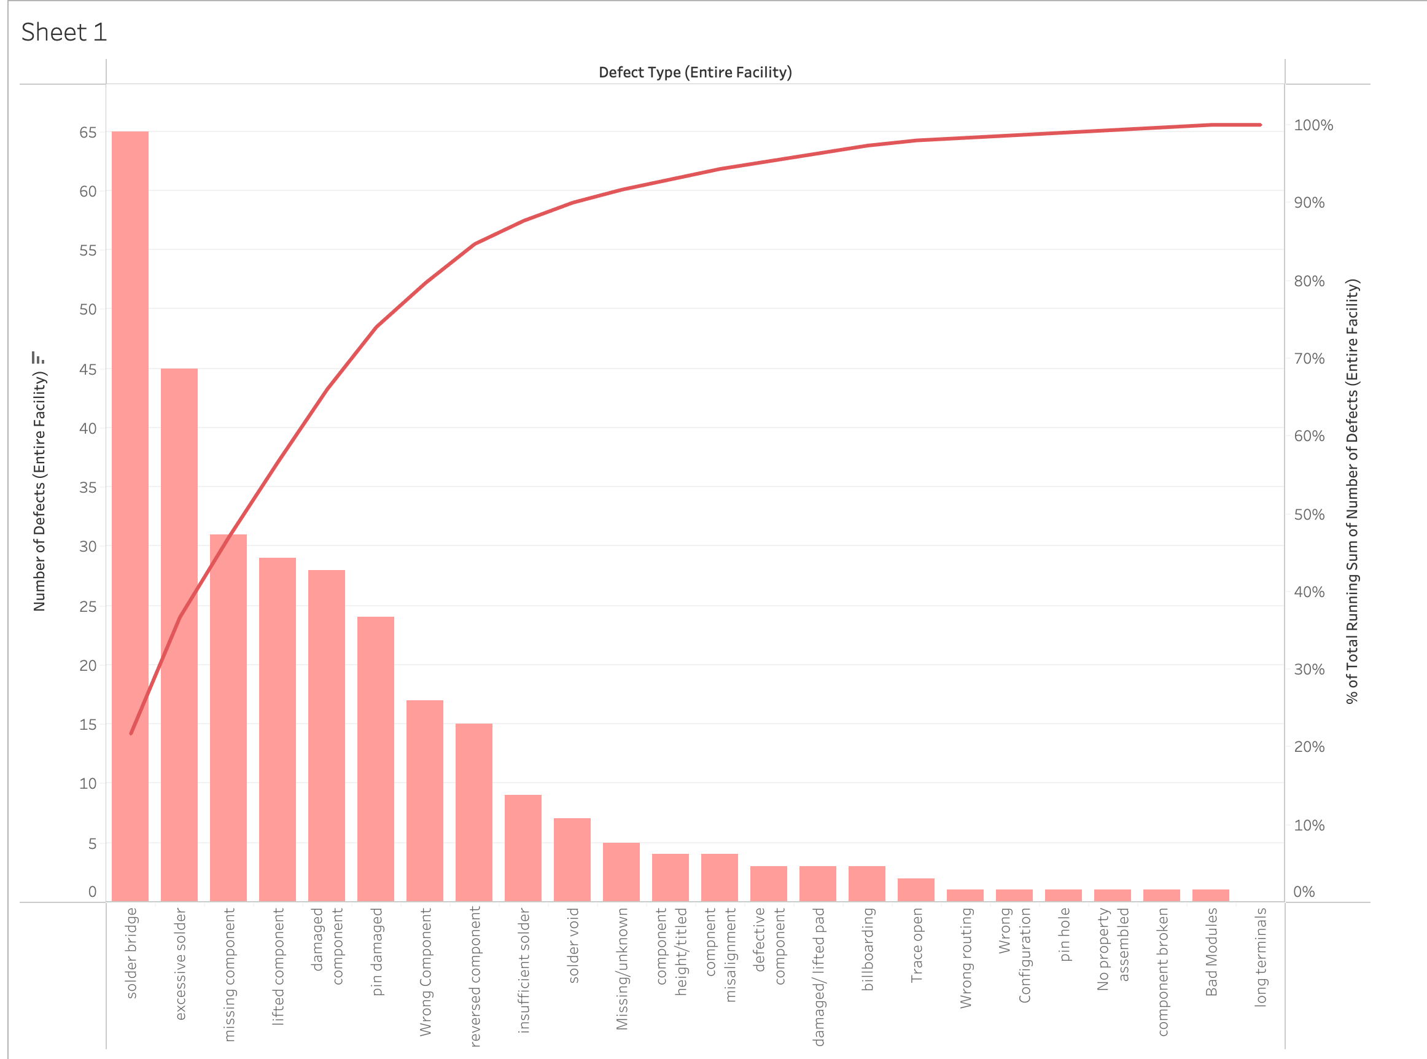
Entire Facility
Notes:
Here we have the pareto chart showing the entire facility. The most defects are found with the solder bridge, excessive solder, missing component, lifted component, damaged component, pin damaged, and wrong component.

Slide 5
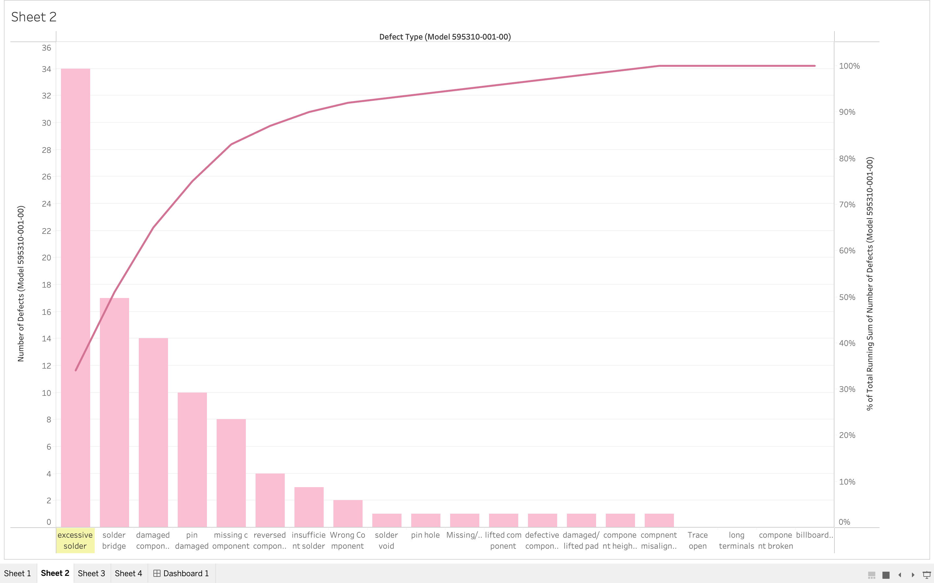
Model 595310-001-00
Notes:
Here is the pareto chart for model 595310-001-00. Analyzing the chart, we can see that the most occurring defect for this model is excessive solder at about 87%. The next two most occurring defects for this model are solder bridge at around 44% and damaged component at about 38%. Excessive solder has 34 defects in this model. The solder bridge has 17 defects, and the damaged component has 14 defects.

Slide 6
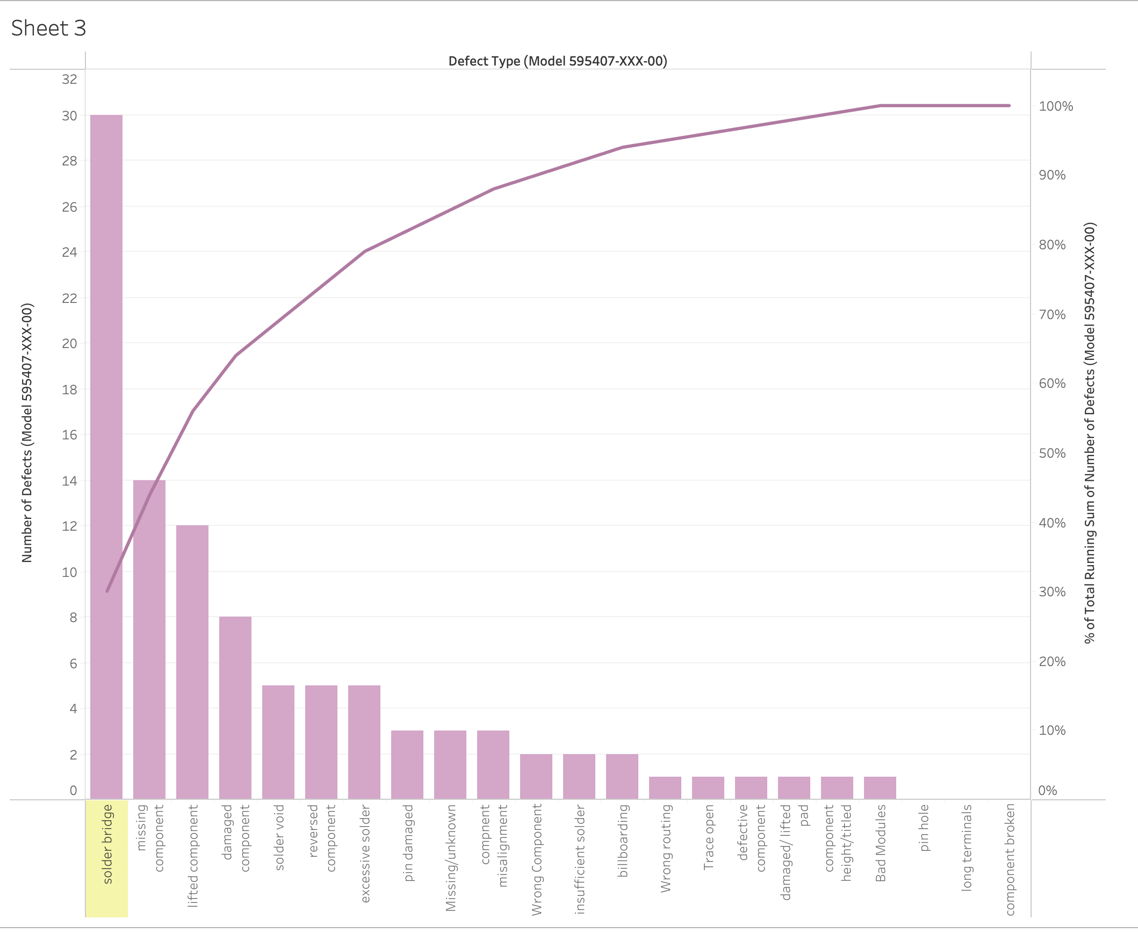
Model 595407-XXX-00
Notes:
This next pareto chart displays the data from model 595407-XXX-00. Looking at the chart we can see that about 85% of the defects with this model are due to the solder bridge. The next most occurring defect is the missing component at about 40%. Lastly the third defect that has happened the most within this model is with the lifted component at about 35%. With this model the most significant cause of defects is solder bridge with 30 defects, missing component with 14 defects, and lifted component with 12 total defects.

Slide 7
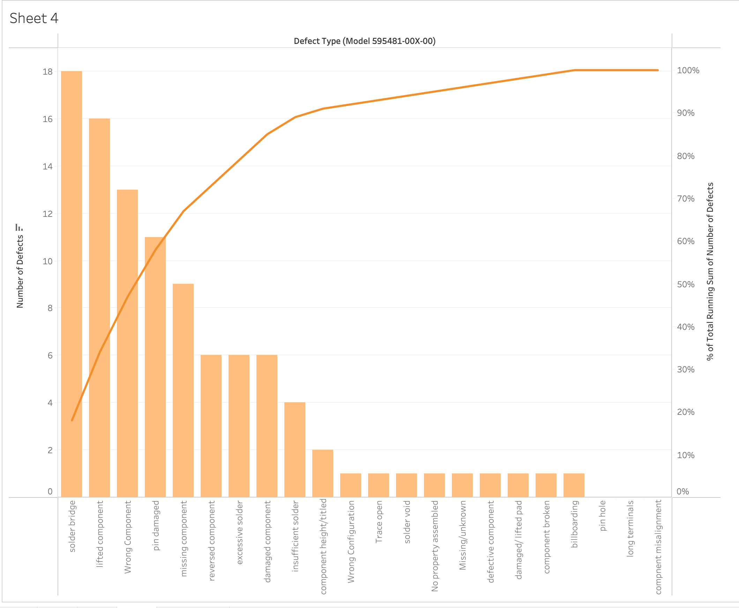
Model 595481-00X-00
Notes:
This is the pareto chart for model 595481-00X-00. The data in this chart shows that solder bridge contributes to the greatest number of defects at 90%. We then have lifted component next with 80% of defects. Lastly, the third and fourth part that produces the majority of defects are wrong component at about 65% and pin damaged at about 55%. For this model solder bridge had 18 defects, lifted component had 16 defects, pin damaged had 11 defects, and missing component had 9 defects.

Slide 8
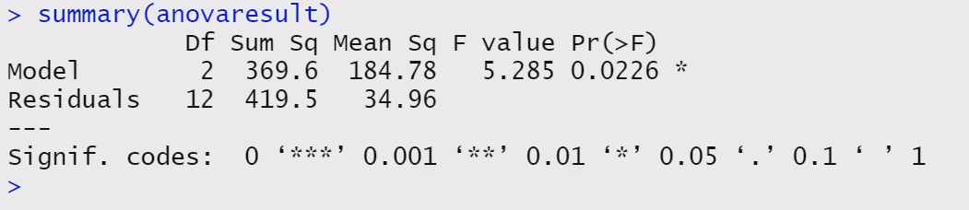
Hypothesis and ANOVA Tests
A hypothesis test was created along with an ANOVA test for this case study.
These tests will aid in determining which model has a significant difference in defects.
The ANOVA test shows that the F-statistic is 5.285 and the p-value is 0.0226.
Notes:
The hypothesis is that there is a statistical difference in the percentage of defects between the three different production lines that is significant. To complete the hypothesis test with the sample evidence we used R. I first imported the data into the R script using the df <- read.csv function. Once the data set was imported, I was able to run a one-way ANOVA test on the sample evidence data set. To perform a one-way ANOVA test I used the aov() function. After running the one-way ANOVA test we can see that the F-statistic is 5.285 and the p-value is 0.0226. With these results we can say that there is a significant difference between the defect percentages across the three models.

Slide 9
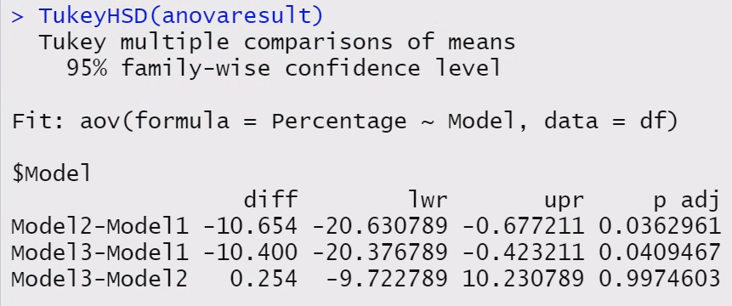
TukeyHSD
Notes:
After the ANOVA test I proceeded to use the TukeyHSD() function to provide a comparison of the means between the models. The TukeyHSD analysis shows a significant difference between the Model 1 compared to the other two models. We do not see any significant differences between Model 2 and Model 3. With the information gathered, we can come to the conclusion that the null hypothesis will have to be rejected. The alternative hypothesis would be accepted. So, there is a significant difference in percentage of defects between the models specifically Model 1 compared to Model 2 and Model 3. With this information proceeding forward, we should take a deeper look into the manufacturing process of Model 1 and what could be the cause of the defects.

Slide 10

Analysis Findings
The Hypothesis and ANOVA tests show that the null hypothesis is rejected, and the alternative hypothesis is favored for there being a significant difference in percentages between the three production models.
The TukeyHSD function also showed a significant difference between model 1 in comparison to the other two models.
The pareto charts and test results can be used to show the stakeholders which defects have the highest rates and what model needs to be investigated further.
Looking to correct the defects with model 1 can help the overall defect percentage for the entire facility.
Based on our findings completing a project to improve the manufacturing defects can provide a 20% reduction in defects and increase capacity by 20%.
Notes:
In summary, after performing the hypothesis and ANOVA tests we rejected the null hypothesis and accepted the alternative hypothesis of there is a significant difference in defect percentages between the three production models. We then proceeded to use the TukeyHSD function which showed us a significant difference between model 1 in comparison to model 2 and model 3. Our pareto charts that were created for the entire facility and each of the models can be utilized in showing the stakeholders what model ultimately produces the most amount of defects. We then can look into model 1 because it has shown to have the highest percentage of defects. Based on our findings we can attempt the solution of completing a project that will improve the manufacturing defects with a 20% reduction in the defects generated during the welding process in the three double production lines of the Manual Finish area and a 20% increase in the capacity of the three double production lines.

Slide 11
References
Midway, S. (n.d.) “Chapter 7 Understanding ANOVA in R.” https://bookdown.org/steve_midway/DAR/understanding-anova-in-r.html
finnstats (August 28, 2021) “How to Perform Tukey HSD Test in R.” r-bloggers https://www.r-bloggers.com/2021/08/how-to-perform-tukey-hsd-test-in-r/
Southern New Hampshire University (n.d.) “DAT 475 Project Case Study” https://learn.snhu.edu/content/enforced/1610838-DAT-475-12752.202451-1/course_documents/DAT%20475%20Project%20Case%20Study.pdf?ou=1610838

